Slide 1
Revision 3: Automated systems, AI and logic
Y11 - Cambridge IGCSE Computer Science 0478
1
Notes:
Third revision lesson. Paper 1 topic 6 (automated systems, robotics, AI) and topic 10 logic gates, which the practice exam tests on Paper 2 (draw a circuit from an expression with a maximum of two inputs per gate, then complete the truth table). Task 1 is a recall test on Revision 2.

Slide 2
Recall test: Revision 2
Starter activity
Task 1 | Recall test on Revision 2
Marks | 10
Time | 6 minutes
Rules | Closed book
Then | Swap and mark
2
Notes:
Task 1: 10 questions on Revision 2, closed book, 6 minutes.

Slide 3
In this lesson, you will
Objectives
Describe how an automated system uses sensors, a microprocessor and actuators
Describe the characteristics of a robot, and its benefits and drawbacks
Describe the characteristics of AI, machine learning and expert systems
Recognise the six logic gates and their truth tables
Draw a logic circuit from an expression or a problem, and complete its truth table
3

Slide 4
Automated systems
Automated systems
1
Sensor
2
Microprocessor
3
Actuator
4
Repeat
Takes readings, e.g. temperature, light, moisture. Data converted to digital.
Compares the data with stored values or a range.
If the value is out of range, a signal switches a motor, fan, valve or heater on/off.
The process loops continuously.
Benefits | Drawbacks
Faster and more accurate than a person | Expensive to set up and maintain
Works 24 hours a day | Can malfunction - may need a person to fix
Safer - no person in a dangerous place | Can be hacked
Consistent results | May replace jobs
4
Notes:
An automated system uses sensors, a microprocessor and actuators to carry out a task without human input. The sensor takes readings and sends data (converted from analogue to digital by an ADC); the microprocessor compares the data with stored values/a range; if outside the range it sends a signal to an actuator to switch something on/off; this repeats continuously. Benefits: faster, more accurate/consistent, works 24/7, safer, fewer staff. Drawbacks: expensive to set up/maintain, can fail/malfunction, can be hacked, job losses.

Slide 5
Robotics
Robotics
1
Mechanical structure
2
Electrical components
3
Programmable
A physical framework, e.g. arms, wheels, grippers.
Sensors, microprocessor and actuators.
It follows instructions that can be changed.
Who? | Benefits | Drawbacks
Company | Works 24/7, no wages, consistent quality, fewer errors | Expensive to buy and maintain; production stops if it breaks
Employees | No heavy, dangerous or repetitive tasks; new jobs maintaining robots | Job losses; deskilling
Customers | Faster service, consistent products | No human contact; may not cope with unexpected situations
Apply your answer to the person in the question: the company, the workers or the customer.
5
Notes:
The three characteristics of a robot (exam answer): a mechanical structure/framework; electrical components (sensors, microprocessors, actuators); programmable. Robots can be used in factories, homes (vacuum cleaners), delivery, medicine, agriculture, drones. Always apply benefits/drawbacks to the person asked about in the question - e.g. benefit to the company (works 24/7, no wages, consistent quality) vs to employees (no dangerous/heavy/repetitive tasks) vs to customers.

Slide 6
Artificial intelligence
AI
1
Collection of data
2
Rules for using data
A large amount of data about the problem.
Rules that decide what to do with the data.
3
Ability to reason
4
Ability to learn and adapt
Draws conclusions and makes predictions or decisions.
Machine learning: changes its own rules and data from experience.
Machine learning: the system changes its data or rules from feedback, so it improves without being reprogrammed.
6
Notes:
Characteristics of AI from the syllabus: the collection of data; the rules for using that data; the ability to reason; the ability to learn and adapt (some systems). Machine learning: the program changes its own data/rules based on feedback/results, so it improves over time without being reprogrammed. Examples: search engines, recommendation systems, self-driving cars, chatbots, game characters.

Slide 7
Expert systems
AI
1
Interface
2
Knowledge base
The user enters data / answers questions and sees the results.
Stores the facts about the subject.
3
Rule base
4
Inference engine
Stores the rules, e.g. IF symptom = fever AND rash THEN ...
Applies the rules to the knowledge base and the inputs; decides what to ask next; gives the diagnosis.
Examples: medical diagnosis, car repair, mineral prospecting. Output usually includes a likelihood (%).
7
Notes:
Four components: interface (user inputs data/answers questions, sees output); knowledge base (facts); rule base (IF-THEN rules); inference engine (applies the rules in the rule base to the knowledge base and the input data to reach a conclusion, and decides what to ask next). Examples: medical diagnosis, car repair, mineral prospecting.

Slide 8
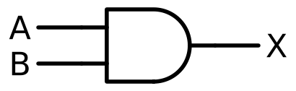
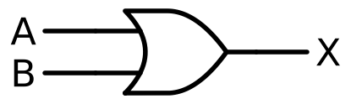
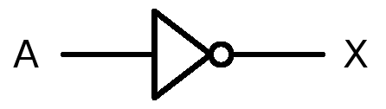
Logic gates (1)
Logic gates
AND
OR
NOT
A | B | X
0 | 0 | 0
0 | 1 | 0
1 | 0 | 0
1 | 1 | 1
A | B | X
0 | 0 | 0
0 | 1 | 1
1 | 0 | 1
1 | 1 | 1
A | X
0 | 1
1 | 0
X is 1 only when A AND B are both 1
X is 1 when A OR B (or both) is 1
X is the opposite of A (one input only)
8
Notes:
Students must be able to draw each symbol and write its truth table. NOT has one input; the small circle on a symbol means "NOT the output".

Slide 9
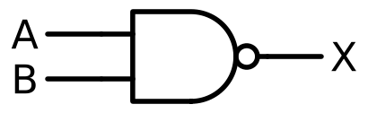
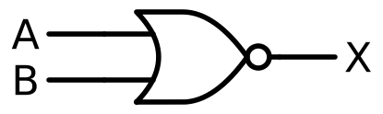

Logic gates (2)
Logic gates
NAND
NOR
XOR
A | B | X
0 | 0 | 1
0 | 1 | 1
1 | 0 | 1
1 | 1 | 0
A | B | X
0 | 0 | 1
0 | 1 | 0
1 | 0 | 0
1 | 1 | 0
A | B | X
0 | 0 | 0
0 | 1 | 1
1 | 0 | 1
1 | 1 | 0
NOT AND: X is 0 only when both inputs are 1
NOT OR: X is 1 only when both inputs are 0
X is 1 when the inputs are different
9
Notes:
NAND and NOR are AND and OR with the output inverted - draw the bubble on the output. XOR = exclusive OR: 1 when the inputs are different.

Slide 10
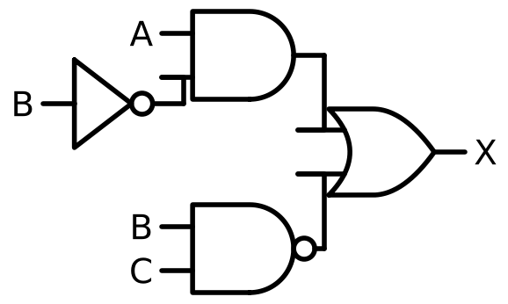
From expression to circuit
Logic gates
X = (A AND NOT B) OR (B NAND C)
1
Brackets first
Each bracket becomes one gate (or two, with a NOT).
2
NOT on an input
Draw the NOT gate just before the gate that uses it.
3
Join last
The operator between the brackets is the final gate.
4
Two inputs max
Do not simplify - draw every gate in the expression.
10
Notes:
Worked example: X = (A AND NOT B) OR (B NAND C). Work from the inside of the brackets outwards: NOT B first, then A AND (NOT B), then B NAND C, then OR the two results. Each gate has a maximum of two inputs; do not simplify; an input can branch to more than one gate (B is used twice). One mark per correct gate with the correct inputs in the exam.

Slide 11
Truth tables with working
Logic gates
A | B | C | A AND NOT B | B NAND C | X
0 | 0 | 0 | 0 | 1 | 1
0 | 0 | 1 | 0 | 1 | 1
0 | 1 | 0 | 0 | 1 | 1
0 | 1 | 1 | 0 | 0 | 0
1 | 0 | 0 | 1 | 1 | 1
1 | 0 | 1 | 1 | 1 | 1
1 | 1 | 0 | 0 | 1 | 1
1 | 1 | 1 | 0 | 0 | 0
1
8 rows
Three inputs give 2³ = 8 rows: count 000 to 111 in binary.
2
Working columns
One column for each bracket - then combine them.
3
Marks
4 marks for 8 correct outputs; each wrong row costs marks.
11
Notes:
Use working columns for each bracket, then combine. 3 inputs = 8 rows, counting in binary 000 to 111. Exam marking: 4 marks for 8 correct outputs, 3 for 6-7, 2 for 4-5, 1 for 2-3 - so every row counts. Here: A AND NOT B is 1 only when A = 1 and B = 0; B NAND C is 0 only when B = 1 and C = 1.

Slide 12
From a problem to an expression
Logic gates
Input | 0 | 1
T temperature | normal | too high
W window | closed | open
H humidity | normal | too high
1
Find each condition
"temperature too high" = T, "window closed" = NOT W, "humidity too high" = H
2
Use the joining words
A greenhouse fan F switches on if the temperature is too high and the window is closed, or if the humidity is too high.
"and" = AND, "or" = OR - keep the brackets the sentence implies
3
Check with a row
F = (T AND NOT W) OR H
T = 1, W = 0, H = 0 → F = 1 ✓
12
Notes:
Exam questions describe a situation with a table of what 0 and 1 mean for each input. Turn each condition into a bracket: "is high" = T (T = 1), "is closed" = NOT W if W = 1 means open. Then join with AND / OR as the sentence says. Then draw the circuit or complete the truth table.

Slide 13
Logic exam tips
Exam skills
Do | Do not
Use a maximum of two inputs per gate | Simplify the expression
Draw one gate for every operator | Forget the NOT gates
Use working columns in the truth table | Skip rows - each output can earn marks
Draw the symbols carefully: bubble = NOT | Confuse OR and XOR (XOR has the extra curved line)
13
Notes:
Common errors seen in mark schemes: gates with three inputs, simplifying the expression, missing NOT gates, drawing AND with a bubble (that is NAND), not labelling inputs.

Slide 14
Your tasks
Guided practice
Task | Topic | Marks
1 | Recall test on Revision 2 | 10
2 | Automated systems and robots | 18
3 | AI and expert systems | 13
4 | Logic gates and truth tables | 10
5 | Logic circuits from expressions and problems | 23
6 | Extension: more logic circuits | 13
14

Slide 15
In this lesson, you
Summary
Described automated systems: sensor, microprocessor, actuator
Described robots and their benefits and drawbacks
Described AI, machine learning and expert systems
Used the six logic gates and their truth tables
Drew logic circuits and truth tables from expressions and problems
Next: Revision 4 - algorithms and programming.
15

